Slide 1
Database Technologies - MySQL
A day without new knowledge is a lost day.
Before we start DBT module.
Which module(s) you have completed?
If A and a, B and b, C and c etc. are treated in the same way then it is case-insensitive. MySQL is case-insensitive
In this module we are going to learn SQL, PL/SQL and NoSQL(MongoDB)

Slide 2
Introduction
If anyone who wants to develop a good application
then he should have the knowledge three major components.
They are . . . . .
Presentation Layer [ UI ]
Application Layer [ Server Application and Client Application ]
Data Layer [ Data Access Object (DAO) / Data Access Layer (DAL) ] { Flat Files | RDBMS | NoSQL }

Slide 3
Introduction
Why do we need databases (Use Case)?
We need databases because they organize data in a manner which allows us to store, query, sort, and manipulate data in various ways. Databases allow us to do all this things.
Many companies collects data from different resource (like Weather data, Geographical data, Finance data, Scientific data, Transport data, Cultural data [Cultural means: the ideas, customs, and social behaviour of a particular person or society.] , etc.)

Slide 4
Remember:
A reference is a relationship between two tables where the values in one table refer to the values in another table.
A referential key is a column or set of columns in a table that refers to the primary key of another table. It establishes a relationship between two tables, where one table is called the parent table, and the other is called the child table.
What is Relation and Relationship?

Slide 5
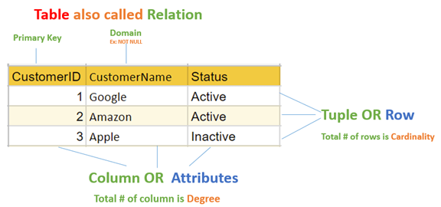
relation and relationship?
Relation (in Relational Algebra "R" stands for relation): In Database, a relation represents a table or an entity (in ERD) than contain attributes.
Relationship: In database, relationship is that how the two entities are connected to each other, i.e. what kind of relationship type they hold between them.
Primary/Foreign key is used to specify this relationship.
Remember:
Foreign Key is also know as
referential constraint
referential integrity constraint. (Referential integrity constraint is the state of a database in which all values of all foreign keys are valid.)
Note:
Table - The physical instantiation of a relation in the database schema.
Relation - A logical construct that organizes data into rows and columns.

Slide 6
File Systems is the traditional way to keep your data organized.
File System
vs
DBMS

Slide 7
file-oriented system
struct Employee {
int emp_no;
char emp_name[50];
int salary;
} emp[1000];
struct Employee {
int emp_no;
char emp_name[50];
int salary;
};
struct Employee emp[1000];
File Anomalies
c:\employee.txt
c:\employee.txt
c:\employee.txt
c:\employee.txt
c:\employee.txt
1 suraj 4000
2 ramesh 6000
3 rajan 4500
. |
. |
. |
500 sam 3500
. |
. |
. |
1000 amit 2300
1 suraj 4000
2 ramesh 6000
3 rajan 4500
. |
. |
. |
500 sam 3500
. |
. |
1000 amit 2300
. |
. |
. |
2000 jerry 4500
. |
. |
1 suraj 4000
2 ramesh 6000
3 rajan 4500
. |
. |
500 sam 3500
. |
3 rajan 4500
. |
sam 3500
. |
. |
1000 amit 2300
1 suraj 4000
2 ramesh 6000
3 rajan 4500
. |
. |
sam 500 3500
. |
ram 550 5000
. |
1000 amit 2300
1 suraj 4000
2 ramesh 6000
3 rajan 4500
. |
500 sam 3500
. |
600 neel 4500

Slide 8
Create/Open an existing file
Reading from file
Writing to a file
Closing a file
file-oriented system
File Anomalies
c:\employee.txt
file attributes
file permissions
search empl ID=1
search emp_name
1 suraj 4000
2 ramesh 6000
3 rajan 4500
. |
. |
. |
500 sam 3500
. |
. |
. |
1000 amit 2300
File Name
Type
Location
File permissions
Share permissions
1 suraj 4000
2 ramesh 6000
3 rajan 4500
. |
. |
. |
500 sam 3500
. |
. |
. |
1000 amit 2300
1 suraj 4000
2 ramesh 6000
3 rajan 4500
. |
. |
. |
500 sam 3500
. |
. |
. |
1000 amit 2300

Slide 9
advantages of file-oriented system
The biggest advantage of file-based storage is that anyone can understand the system.
Advantage of File-oriented system
Backup: It is possible to take faster and automatic back-up of database stored in files of computer-based systems.
Data retrieval: It is possible to retrieve data stored in files in easy and efficient way.
Editing: It is easy to edit any information stored in computers in form of files.
Remote access: It is possible to access data from remote location.
Sharing: The files stored in systems can be shared among multiple users at a same time.

Slide 10
disadvantage of file-oriented system
The biggest disadvantage of file-based storage is as follows.
Disadvantage of File-oriented system
Data redundancy: It is possible that the same information may be duplicated in different files. This leads to data redundancy results in memory wastage.
(Suppose a customer having both kind of accounts- saving and current account. In such a situation a customers detail are stored in both the file, saving.txt- file and current.txt- file , which leads to Data Redundancy.)
Data inconsistency: Because of data redundancy, it is possible that data may not be in consistent state.
(Suppose customer changed his/her address. There might be a possibility that address is changed in only one file (saving.txt) and other (current.txt) remain unchanged.)
Limited data sharing: Data are scattered in various files and also different files may have different formats (for example: .txt, .csv, .tsv and .xml) and these files may be stored in different folders so, due to this it is difficult to share data among different applications.
Data Isolation: Because data are scattered in various files, and files may be in different formats (for example: .txt, .csv, .tsv and .xml), writing new application programs to retrieve the appropriate data is difficult.
Data security: Data should be secured from unauthorized access, for example a account holder in a bank should not be able to see the account details of another account holder, such kind of security constraints are difficult to apply in file processing systems.

Slide 11

Relation Schema:
e.g. student (roll_no int, name varchar, address varchar, phone varchar and age int) is relation schema for STUDENT
A relation schema represents name of the relation with its attributes.
DBMS
The database management system (DBMS) is the software that interacts with end users, applications, and the database itself to store and analyze the data.
database: Is the collection of related data which is organized, database can store and retrieve large amount of data easily, which is stored in one or more data files by one or more users, it is called as structured data.
management system: it is a software, designed to define, manipulate, retrieve and manage data in a database.

Slide 12



relational database management system?
A RDBMS is a database management system (DBMS) that is based on the relational model introduced by Edgar Frank Codd at IBM in 1970.
RDBMS supports
client/server Technology
Highly Secured
Relationship (PK/FK)
A server is a computer program or a device that provides service to another computer program and its user, also known as the client.
In the client/server programming model, a server program awaits and fulfills requests from client programs, which might be running in the same, or other computers.

Slide 13
object relational database management system?
An object database is a database management system in which information is represented in the form of objects.
PostgreSQL is the most popular pure ORDBMS. Some popular databases including Microsoft SQL Server, Oracle, and IBM DB2 also support objects and can be considered as ORDBMS.

Slide 14
relational model concepts
and
properties of relational table

Slide 15
relational model concepts
Relational model organizes data into one or more tables (or "relations") of columns and rows. Rows are also called records or tuples. Columns are also called attributes.
Tables − In relational model, relations are saved in the form of Tables. A table has rows and columns.
Attribute − Attributes are the properties that define a relation. e.g. (roll_no, name, address, phone and age)
Tuple − A single row of a table, which contains a single record for that relation is called a tuple.
Relation schema − A relation schema describes the relation name (table name) with its attribute (column) names.
Attribute domain − An attribute domain specifies the data type, format, constraints of a column, and defines the range of values that are valid for that column.
Relation key − Each row has one or more attributes, known as relation key, which can identify the row in the relation (table) uniquely.
e.g. student(prn, name, address, phone, DoB, age, hobby, email, status) is relation schema for student relation.
Remember:
In database management systems, NULL is used to represent MISSING or UNKNOWN data in a table column.

Slide 16
properties of relational table
ID | job | firstName | DoB | salary
1 | manager | Saleel Bagde | yyyy-mm-dd | ●●●●●●
3 | salesman | Sharmin | yyyy-mm-dd | ●●●●●●
4 | accountant | Vrushali | yyyy-mm-dd | ●●●●●●
2 | salesman | Ruhan | yyyy-mm-dd | ●●●●●●
5 | 9500 | manager | yyyy-mm-dd | ●●●●●●
5 | Salesman | Rahul Patil | yyyy-mm-dd | ●●●●●●
Relational tables have six properties:
Values are atomic.
Column values are of the same kind. (Attribute Domain: Every attribute has some pre-defined datatypes, format, constraints of a column, and defines the range of values that are valid for that column known as attribute domain.)
Each row is unique.
The sequence of columns is insignificant – (unimportant).
The sequence of rows is insignificant – (unimportant).
Each attribute/column must have a unique name.

Slide 17

What is data?

Slide 18

what is data?
Data is any facts that can be stored and that can be processed by a computer.
Data can be in the form of Text or Multimedia
e.g.
number, characters, or symbol
images, audio, video, or signal
Remember:
A number is a mathematical value used to count, measure, and label.

Slide 19
What is Entity Relationship Diagram?

Slide 20
Entity Relationship Diagram (ER Diagram)
Use E-R model to get a high-level graphical view to describe the "ENTITIES" and their "RELATIONSHIP"
The basic constructs/components of ER Model are
Entity, Attributes and Relationships.

Slide 21
An entity can be a real-world object.
What is Entity?

Slide 22
entity
In relation to a database , an entity is a
Person(student, teacher, employee, department, …)
Place(classroom, building, …) --a particular position or area
Thing(computer, lab equipment, …) --an object that is not named
Concept(course, batch, student’s attendance, …) -- an idea,
about which data can be stored. All these entities have some attributes or properties that give them their identity.
Every entity has its own characteristics.

Slide 23
When you are designing attributes for your entities, you will sometimes find that an attribute does not have a value. For example, you might want an attribute for a person's middle name, but you can't require a value because some people have no middle name. For these, you can define the attribute so that it can contain null values.
In database management systems, null is used to represent missing or unknown data in a table column.
What is an Attribute?
Attributes are the properties that define a relation.
e.g. student(ID, firstName, middleName, lastName, city)
In some cases, you might not want a specific attribute to contain a null value, but you don't want to require that the user or program always provide a value. In this case, a default value might be appropriate. A default value is a value that applies to an attribute if no other valid value is available.
Entity
a₁
a₂
a₃
a₄
…
v₁
v₂
null
pune
…

Slide 24
attributes
A table has rows and columns
In RDBMS, a table organizes data in rows and columns. The COLUMNS are known as ATTRIBUTES / FIELDS whereas the ROWS are known as RECORDS / TUPLE.
In Relation: EMP
Attributes
ID | EmployeeName | Job | Hiredate | Salary
1 | KING | PRESIDENT | 2017-02-15 | 5000
… | … | … | … | …
… | … | … | … | …
… | … | … | … | …
Rows

Slide 25
attributes
In Entity Relationship(ER) Model attributes can be classified into the following types.
Simple/Atomic and Composite Attribute
Single Valued and Multi Valued attribute
Stored and Derived Attributes
Complex Attribute
Remember:
In SQL, the same name can be used for two (or more) attributes as long as the attributes are in different relations.

Slide 26
attributes
Simple / Atomic Attribute --VS-- Composite Attribute
(Can’t be divided further) (Can be divided further)
Single Value Attribute --VS-- Multi Valued Attribute
(Only One value) (Multiple values)
Stored Attribute --VS-- Derived Attribute
(Only One value) (Virtual)
Complex Attribute
(Composite & Multivalued)
Employee ID: An employee ID can be a composite attribute, which is composed of sub-attributes such as department code, job code, and employee number.
Atomic Attribute: An attribute that cannot be divided into smaller independent attribute is known as atomic attribute.
e.g. ID’s, PRN, age, gender, zip, marital status cannot further divide.
Single Value Attribute: An attribute that has only single value is known as single valued attribute.
e.g. manufactured part can have only one serial number, voter card, blood group, price, quantity, branch can have only one value.
Stored Attribute: The stored attribute are such attributes which are already stored in the database and from which the value of another attribute is derived.
e.g. (HRA, DA…) can be derive from salary, age can be derived from DoB, total marks or average marks of a student can be derived from marks.

Slide 27
Composite vs Multi Valued Attribute

Slide 28

composite / multi valued attributes
Composite Attribute
Person Entity
Name attribute: ( firstName, middleName, and lastName )
PhoneNumber attribute: ( countryCode, cityCode, and phoneNumber )
Multi Valued Attribute
Person Entity
Hobbies attribute: [ reading, hiking, hockey, skiing, photography, . . . ]
SpokenLanguages attribute: [ Hindi, Marathi, Gujarati, English, . . . ]
Degrees attribute: [ 10th , 12th, BE, ME, PhD, . . . ]
emailID attribute: [ saleel@gmail.com, salil@yahoomail.com, . . . ]

Slide 29
What is an Prime, Non-Prime Attribute?

Slide 30
attributes
Prime attribute (Entity integrity)
An attribute, which is a part of the prime-key (candidate key), is known as a prime attribute.
Non-prime attribute
An attribute, which is not a part of the prime-key (candidate key), is said to be a non-prime attribute.

Slide 31
Entity Relationship Diagram Symbols

Slide 32
erdplus.com
www.draw.io
entity relationship diagram symbols
Attribute
Composite Attribute
Key Attribute
Strong Entity
Weak Entity
Derived Attribute
Weak Relationship
Relationship
Multivalued Attribute

Slide 33
strong and weak entity
An entity may participate in a relation either totally or partially.
Strong Entity: A strong entity is not dependent on any other entity in the schema. A strong entity will always have a primary key. Strong entities are represented by a single rectangle.
Weak Entity: A weak entity is dependent on a strong entity to ensure its existence. Unlike a strong entity, a weak entity does not have any primary key. A weak entity is represented by a double rectangle. The relation between one strong and one weak entity is represented by a double diamond. This relationship is also known as identifying relationship.
Example 1 – A loan entity can not be created for a customer if the customer doesn’t exist
Example 2 – A payment entity can not be created for a loan if the loan doesn’t exist
Example 3 – A customer address entity can not be created for the customer if the customer doesn’t exist
Example 4 – A prescription entity can not be created for a patient if the patient doesn’t exist

Slide 34
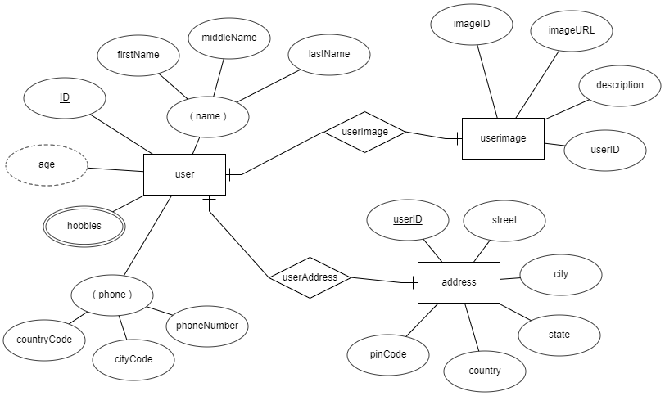
entity relationship diagram
DoB

Slide 35
What is a degree, cardinality, domain and union in database?

Slide 36
What is a degree, cardinality, domain and union in database?
Degree d(R) / Arity: Total number of attributes/columns present in a relation/table is called degree of the relation and is denoted by d(R).
Cardinality |R|: Total number of tuples/rows present in a relation/table, is called cardinality of a relation and is denoted by |R|.
Cardinality is the numerical relationship between rows of one table and rows in another. Common cardinalities include one-to-one, one-to-many, and many-to-many.
Domain: Total range of accepted values for an attribute of the relation is called the domain of the attribute. (Data Type(size))
Union Compatibility: Two relations R and S are set to be Union Compatible to each other if and only if:
They have the same degree d(R).
Domains of the respective attributes should also be same.

Slide 37
What is domain constraint and types of data integrity constraints?

Slide 38
Data integrity refers to the correctness and completeness of data.
A domain constraint and types of data integrity constraints
Domain Constraint = data type + Constraints (not null/unique/primary key/foreign key/check/default)
e.g. custID INT, constraint pk_custid PRIMARY KEY(custID)
Three types of integrity constraints: entity integrity, referential integrity and domain integrity:
Entity integrity: Entity Integrity Constraint is used to ensure the uniqueness of each record the table. There are primarily two types of integrity constraints that help us in ensuring the uniqueness of each row, namely, UNIQUE constraint and PRIMARY KEY constraint.
Referential integrity: Referential Integrity Constraint ensures that there always exists a valid relationship between two tables. This makes sure that if a foreign key exists in a table relationship then it should always reference a corresponding value in the second table t₁[FK] = t₂[PK] or it should be null.
Domain integrity: A domain is a set of values of the same type. For example, we can specify if a particular column can hold null values or not, if the values have to be unique or not, the data type or size of values that can be entered in the column, the default values for the column, etc..

Slide 39
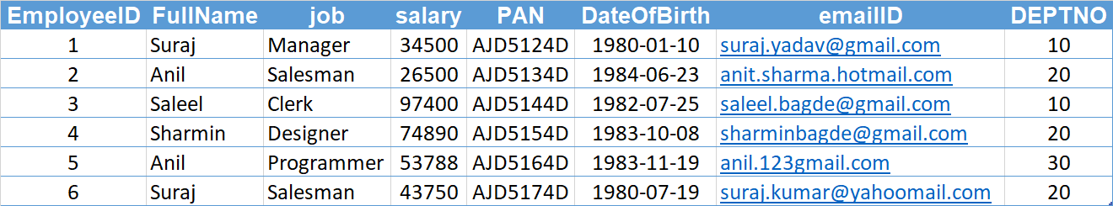
Candidate Key
Primary Key
Composite Key
Alternate Key

Slide 40
Degrees of relationship
The degree of relationship can be defined as the number of occurrences in one entity that is associated with the number of occurrences in another entity.

Slide 41

relationships - binary
The three most common relationships in ER models are Binary, Unary, and Ternary
A binary relationship is when two entities participate and is the most common relationship.

Slide 42
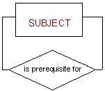
relationships - unary
The three most common relationships in ER models are Binary, Unary, and Ternary
A unary relationship is when both participants in the relationship are the same entity.

Slide 43
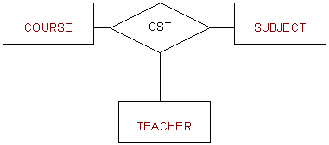
relationships - ternary
The three most common relationships in ER models are Binary, Unary, and Ternary
A ternary relationship is when three entities participate in the relationship.

Slide 44
Common relationships

Slide 45

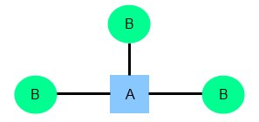
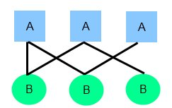
relationships
Common relationship
one-to-one (1:1)
one-to-many (1:M)
many-to-many (M:N)

Slide 46
one-to-one relationship

Slide 47
one-to-one relationship
A one-to-one relationship between two tables means that a row in one table can only relate to zero/one row in the table on the other side of their relationship. This is the least common database relationship.
A one-to-one relationship is a type of cardinality that refers to the relationship between two entities R and S in which one element of entity R may only be linked to zero/one element of entity S, and vice versa.
Country
Capital
Country
Capital
Country
one-to-one relationship
Capital
Country
Capital
=
Country
Capital
Country
Capital

Slide 48
one-to-one relationship
A one-to-one relationship between two tables means that a row in one table can only relate to zero/one row in the table on the other side of their relationship. This is the least common database relationship.
A one-to-one relationship is a type of cardinality that refers to the relationship between two entities R and S in which one element of entity R may only be linked to zero/one element of entity S, and vice versa.
Person-1
Passport-1
Person-1
Passport-1
Person-2
Passport-1
Person-2
Passport-1
one-to-one relationship
=
Person-3
Passport-1
Person-4
Passport-1
Person-4

Slide 49
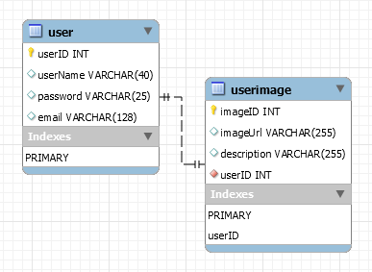
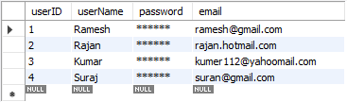
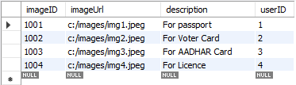
how to create one-to-one relationship
CREATE TABLE user (
userID INT PRIMARY KEY,
userName VARCHAR(40),
password VARCHAR(25),
email VARCHAR(128)
) ;
CREATE TABLE userImage (
imageID INT PRIMARY KEY,
imageUrl VARCHAR(255),
description VARCHAR(255),
userID INT NOT NULL UNIQUE,
FOREIGN KEY(userID) REFERENCES user(userID)
) ;

Slide 50
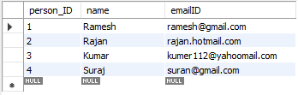

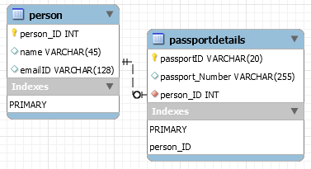
how to create one-to-one relationship
CREATE TABLE person (
person_ID INT PRIMARY KEY ,
name VARCHAR(45),
emailID VARCHAR(128)
);
CREATE TABLE passportDetails (
passportID VARCHAR(20) PRIMARY KEY,
passport_Number VARCHAR(255),
person_ID INT UNIQUE,
FOREIGN KEY(person_ID) REFERENCES person(person_ID)
);

Slide 51
one-to-many relationship

Slide 52
one-to-many relationship
A one-to-many relationship between two tables means that a row in one table can have zero or more row in the table on the other side of their relationship.
a one-to-many relationship is a type of cardinality that refers to the relationship between two entities R and S in which an element of R may be linked to many elements of S, but a member of S is linked to only one element of R.
Customer-1
Order-1
Customer-1
Order-1
Customer-2
Order-1
Customer-2
Order-1
one-to-many relationship
Customer-3
Order-2
=
Customer-2
Order-2
Customer-4
Order-1
Customer-3
Order-1
Customer-5
Order-2
Customer-3
Order-2
Order-3
Customer-3
Order-3
Order-1
Customer-4
Order-1

Slide 53
one-to-many relationship
A one-to-many relationship between two tables means that a row in one table can have one or more row in the table on the other side of their relationship.
a one-to-many relationship is a type of cardinality that refers to the relationship between two entities R and S in which an element of R may be linked to many elements of S, but a member of S is linked to only one element of R.
Invoice-1
Invoice_Item-1
Invoice-1
Invoice_Item-1
Invoice-2
Invoice_Item-1
Invoice-2
Invoice_Item-1
one-to-many relationship
Invoice-3
Invoice_Item-2
=
Invoice-2
Invoice_Item-2
Invoice-4
Invoice_Item-1
Invoice-3
Invoice_Item-1
Invoice_Item-2
Invoice-3
Invoice_Item-2
Invoice_Item-2
Invoice-3
Invoice_Item-3
Invoice_Item-1
Invoice-4
Invoice_Item-1

Slide 54
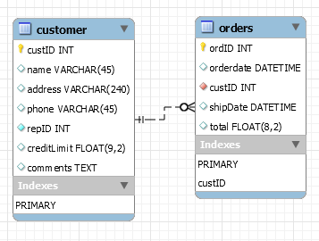
how to create one-to-many relationship
CREATE TABLE customer (
custID INT PRIMARY KEY,
name VARCHAR(45),
address VARCHAR(240),
phone VARCHAR(45),
repID INT NOT NULL,
creditLimit FLOAT(9,2),
comments TEXT,
constraint custid_zero CHECK(custID > 0)
);
CREATE TABLE orders (
ordID INT PRIMARY KEY,
orderdate DATETIME,
custID INT,
shipDate DATETIME,
total FLOAT(8,2),
FOREIGN KEY(custID) REFERENCES customer(custID),
constraint total_greater_zero CHECK(total >= 0)
);

Slide 55
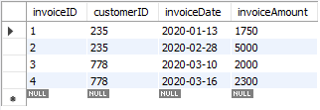
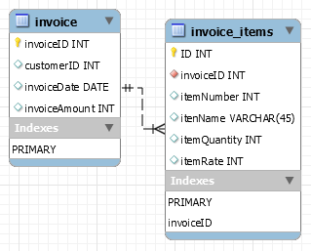
how to create one-to-many relationship
CREATE TABLE invoice (
invoiceID INT PRIMARY KEY,
customerID INT,
invoiceDate DATE,
invoiceAmount INT
);
CREATE TABLE invoice_items (
invoiceID INT,
itemID INT,
itenName VARCHAR(45),
itemQuantity INT,
itemRate INT,
PRIMARY KEY(invoiceID, itemID),
FOREIGN KEY(invoiceID) REFERENCES invoice(invoiceID)
);
CREATE TABLE invoice_items (
invoiceID INT NOT NULL,
itemID INT NOT NULL,
itenName VARCHAR(45),
itemQuantity INT,
itemRate INT,
UNIQUE(invoiceID, itemID),
FOREIGN KEY(invoiceID) REFERENCES invoice(invoiceID)
);

Slide 56
many-to-one relationship

Slide 57
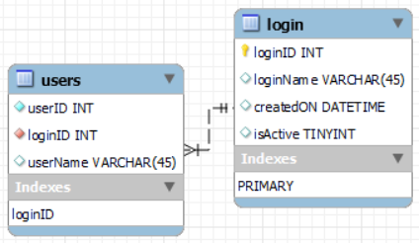
many-to-one relationship
CREATE TABLE users (
userID INT,
loginID INT,
userName VARCHAR(45),
PRIMARY KEY(loginID, userID),
constraint fk_users_login_loginID1 FOREIGN KEY(loginID)
REFERENCES login(loginID)
);
CREATE TABLE users (
userID INT NOT NULL,
loginID INT NOT NULL,
userName VARCHAR(45),
UNIQUE(loginID, userID),
constraint fk_users_login_loginID2 FOREIGN KEY(loginID)
REFERENCES login(loginID)
);
CREATE TABLE login (
loginID INT,
loginName VARCHAR(45),
createdON DATETIME,
isActive TINYINT,
PRIMARY KEY(loginID)
);

Slide 58
many-to-many relationship

Slide 59
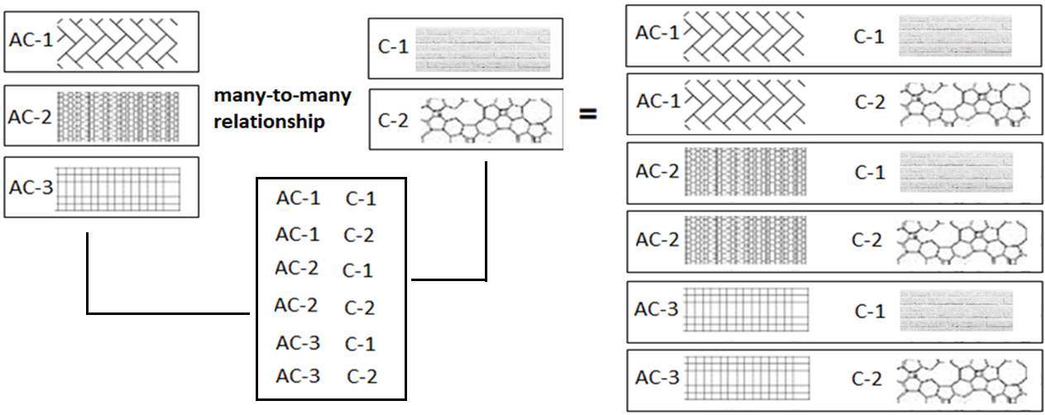
many-to-many relationship
A many-to-many relationship is a type of cardinality that refers to the relationship between two entities R and S in which R may contain a parent instance for which there are many children in S and vice versa.
=
=

Slide 60
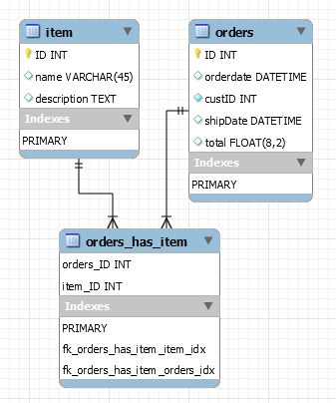
how to create many-to-many relationship
CREATE TABLE item (
ID INT PRIMARY KEY,
name VARCHAR(45),
description TEXT
);
CREATE TABLE orders (
ID INT PRIMARY KEY,
orderdate DATETIME,
custID INT NOT NULL,
shipDate DATETIME,
total FLOAT(8,2),
constraint total_greater_zero CHECK(total >= 0)
);
CREATE TABLE orders_has_item (
orders_ID INT NOT NULL,
item_ID INT NOT NULL,
PRIMARY KEY(orders_ID, item_ID),
constraint fk_orders_has_item_orders FOREIGN KEY(orders_ID)
REFERENCES orders(ID),
constraint fk_orders_has_item_item1 FOREIGN KEY(item_ID)
REFERENCES item(ID)
);

Slide 61
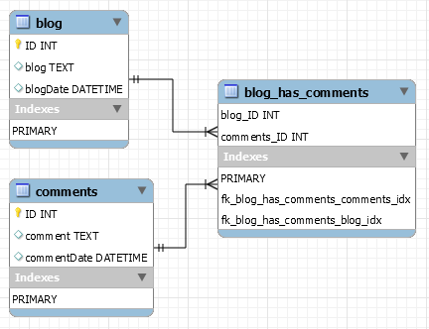
how to create many-to-many relationship
CREATE TABLE blog (
ID INT PRIMARY KEY,
blog TEXT,
blogDate DATETIME
);
CREATE TABLE comments (
ID INT PRIMARY KEY,
comment TEXT,
commentDate DATETIME
);
CREATE TABLE blog_has_comments (
blog_ID INT,
comments_ID INT,
PRIMARY KEY(blog_ID, comments_ID),
constraint fk_blog_has_comments_blog FOREIGN KEY(blog_ID) REFERENCES blog(ID),
constraint fk_blog_has_comments_comments FOREIGN KEY(comments_ID) REFERENCES comments(ID)
);

Slide 62

MySQL
MySQL is the most popular Open Source
Relational Database Management System.
MySQL was created by a Swedish company - MySQL AB that was founded in 1995. It was acquired by Sun Microsystems in 2008; Sun was in turn acquired by Oracle Corporation in 2010.
When you use MySQL, you’re actually using at least two programmes. One program is the MySQL server (mysqld.exe) and other program is MySQL client program (mysql.exe) that connects to the database server.

Slide 63
What is SQL?

Slide 64

what is sql?
Remember:
EXPLICIT or IMPLICIT commit will commit the data.
SQL (Structured Query Language) is a database language designed and developed for managing data in relational database management systems (RDBMS). SQL is common language for all Relational Databases.

Slide 65
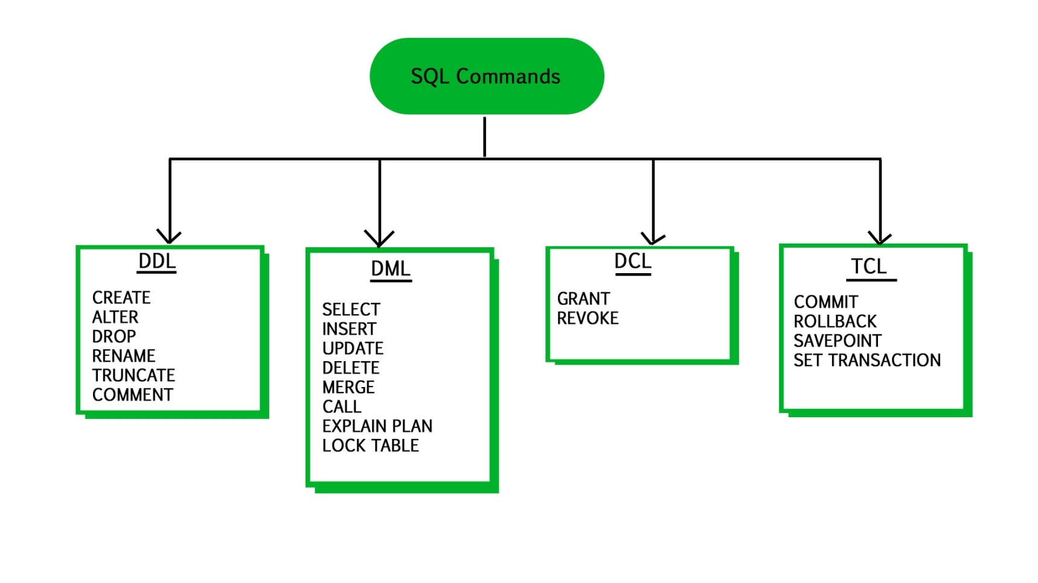
what is sql?
Remember:
An EXPLICIT commit happens when we execute an SQL "COMMIT" command.
An IMPLICIT commits occur without running a "COMMIT" command.
Remember:
A NULL value is not treated as a blank or 0. Null or NULL is a special marker used in Structured Query Language to indicate that a data value does not exist or missing or unknown in the database.
Degree d(R): Total no. of attributes/columns present in a relation/table is called degree of the relation and is denoted by d(R).
Cardinality |R|: Total no. of tuples present in a relation or Rows present in a table, is called cardinality of a relation and is denoted by |R|.

Slide 66
comments in mysql
From a # character to the end of the line.
From a -- sequence to the end of the line.
From a /* sequence to the following */ sequence.
Reconnect to the server | \r
Execute a system shell command | \!
Exit mysql | \q
Change your mysql prompt. | prompt str or \R str

Slide 67
Login to MySQL

Slide 68
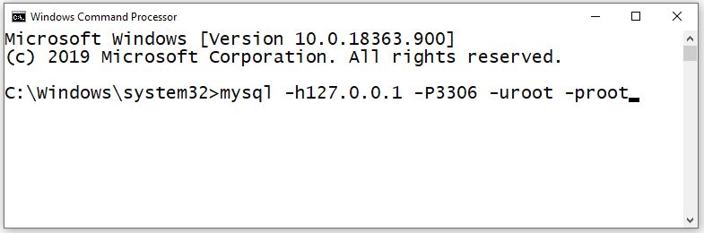
login
Default port for MySQL Server: 3306
C:\> mysql -hlocalhost -P3307 -uroot -p
C:\> mysql -h127.0.0.1 -P3307 -uroot -p [database_name]
C:\> mysql -h192.168.100.14 -P3307 -uroot -psaleel [database_name]
C:\> mysql --host localhost --port 3306 --user root --password=ROOT [database_name]
C:\> mysql --host=localhost --port=3306 --user=root --password=ROOT [database_name]

Slide 69
Before MySQL version 5.5, MyISAM is the default storage engine.
From version 5.5, MySQL uses InnoDB as the default storage engine.
STORAGE ENGINES
A storage engine is a software module that a database management system uses to create, read, update data from a database. There are two types of storage engines in MySQL: transactional and non-transactional.
Storage Engine | File on disk
MEMORY | Data is not stores on the disk
InnoDB | .idb (data and index)
MyISAM | MYD (data), .MYI (index)
CSV | .CSV (data), CSM (metadata)

Slide 70
SHOW ENGINES Syntax
For MySQL 5.5 and later, the default storage engine is InnoDB. The default storage engine for MySQL prior to version 5.5 was MyISAM.
SHOW [STORAGE] ENGINES
SHOW ENGINES displays status information about the server's storage engines. This is particularly useful for checking whether a storage engine is supported, or to see what the default engine is.
INFORMATION_SCHEMA.ENGINES
show engines;
show STORAGE engines;
INFORMATION_SCHEMA provides access to database metadata, information about the MySQL server such as the name of a database or table, the data type of a column, or access privileges.

Slide 71
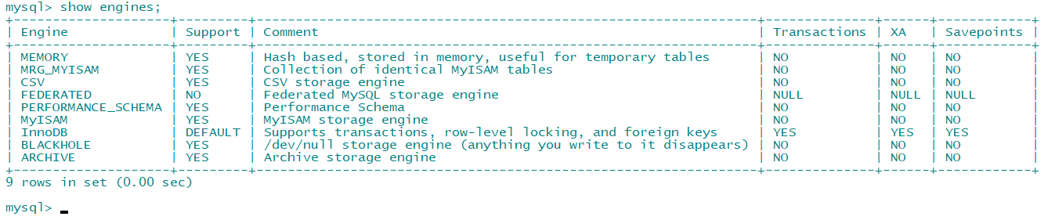
ENGINES
show engines;
show STORAGE engines;
SET DEFAULT_STORAGE_ENGINE = MyISAM;

Slide 72
ENGINES
MEMORY tables are visible to another client, but TEMPORARY tables are not visible to another client.
InnoDB is the most widely used storage engine with transaction support. It is the only engine which provides foreign key referential integrity constraint. Oracle recommends using InnoDB for tables except for specialized use cases.
MyISAM is the original storage engine. It is a fast storage engine. It does not support transactions. MyISAM provides table-level locking. It is used mostly in Web and data warehousing.
Memory storage engine creates tables in memory. It is the fastest engine. It provides table-level locking. It does not support transactions. Memory storage engine is ideal for creating temporary tables or quick lookups. The data is lost when the database is re-started.
CSV stores data in CSV files. It provides great flexibility because data in this format is easily integrated into other applications.

Slide 73
SHOW DATABASES

Slide 74
SHOW DATABASES Syntax
SHOW {DATABASES | SCHEMAS} [LIKE 'pattern' | WHERE expr]
SHOW SCHEMAS is a synonym for SHOW DATABASES.
SHOW DATABASES;
SHOW SCHEMAS;
SHOW DATABASES LIKE 'U%';
SHOW SCHEMAS LIKE 'U%';
NULL means “no database is selected”. Issue the USE dbName command to select the database.

Slide 75
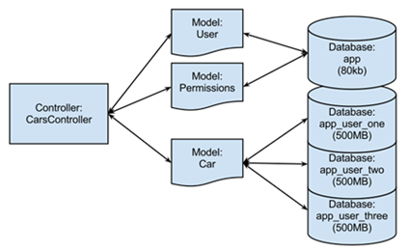
USE DATABASES
The USE db_name statement tells MySQL to use the db_name database as the default (current) database for subsequent statements. The database remains the default until the end of the session or another USE statement is issued.

Slide 76
USE DATABASES Syntax
USE db_name
\U db_name
Note:
USE, does not require a semicolon.
USE must be followed by a database name.
USE db1
\U db1

Slide 77
CREATE DATABASE
ALTER DATABASE

Slide 78
create / alter database
CREATE DATABASE creates a database with the given name. To use this statement, you need the CREATE privilege for the database.
CREATE {DATABASE | SCHEMA} [IF NOT EXISTS] db_name
ALTER {DATABASE | SCHEMA} [db_name] READ ONLY [=] { 0 | 1}
CREATE SCHEMA is a synonym for CREATE DATABASE.
CREATE DATABASE db1;
CREATE DATABASE IF NOT EXISTS db1;
ALTER DATABASE db1 READ ONLY = 0; // is in read write mode.
ALTER DATABASE db1 READ ONLY = 1; // is in read only mode.
Note:
It is not possible to Create, Alter, Drop any object, and Write (Insert, Update, and Delete rows) in a read-only database.
TEMPORARY tables; it is possible to create, alter, drop, and write (Insert, Update, and Delete rows) to TEMPORARY tables in a read-only database.

Slide 79
DROP DATABASE
If the default database is dropped, the default database is unset (the DATABASE() function returns NULL).

Slide 80
drop database
DROP DATABASE drops all tables in the database and deletes the database. Be very careful with this statement! To use DROP DATABASE, you need the DROP privilege on the database.
DROP {DATABASE | SCHEMA} [IF EXISTS] db_name
DROP SCHEMA is a synonym for DROP DATABASE.
DROP DATABASE db1;
DROP DATABASE IF EXISTS db1;

Slide 81
Source Command

Slide 82
source command
You can execute an SQL script file using the source command or \. command
\. file_name
source file_name
\. 'D:\mysqldemobld7.sql'
SOURCE 'D:\mysqldemobld7.sql'
SOURCE //infoserver1/infodomain1/Everyone/DBT/mysqldemobld7.sql

Slide 83
SHOW COLUMNS

Slide 84
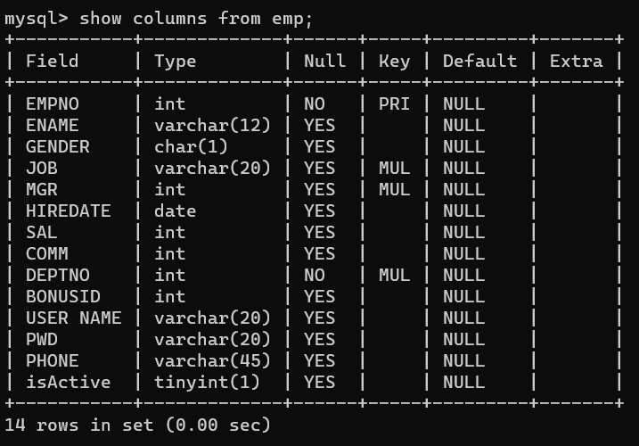
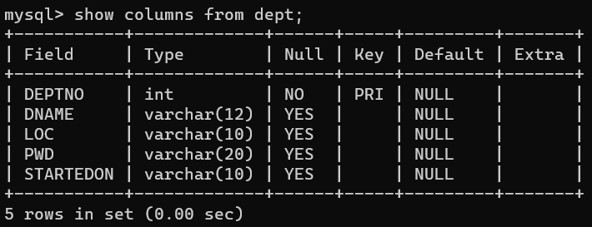
EMP & DEPT Table structure

Slide 85
SHOW COLUMNS Syntax
SHOW [FULL] {COLUMNS | FIELDS} {FROM | IN} tbl_name [{FROM | IN} db_name] [LIKE 'pattern' | WHERE expr]
SHOW COLUMNS FROM emp;
SHOW COLUMNS IN emp;
SHOW FULL COLUMNS FROM emp; # WITH PRIVILEGES
SHOW COLUMNS FROM emp FROM dbName;
SHOW COLUMNS FROM user01.emp;
SHOW COLUMNS FROM emp LIKE 'E%’; # STARTING WITH E
SHOW COLUMNS FROM emp WHERE FIELD IN ('ename'); # ONLY ENAME COLUMN

Slide 86
SHOW TABLES

Slide 87
SHOW TABLES Syntax
SHOW [FULL] TABLES [{FROM | IN} db_name] [LIKE 'pattern' | WHERE expr]
SHOW TABLES;
SHOW FULL TABLES; // WITH TABLE TYPE
SHOW TABLES FROM USER01;
SHOW TABLES WHERE TABLES_IN_USER01 LIKE 'E%' OR TABLES_IN_USER01 LIKE 'B%';
SHOW TABLES WHERE TABLES_IN_USER01 IN ('EMP');

Slide 88
The char is a fixed-length character data type,
The varchar is a variable-length character data type.
CREATE TABLE temp (c1 CHAR(10), c2 VARCHAR(10));
INSERT INTO temp VALUES('SALEEL', 'SALEEL');
SELECT * FROM temp WHERE c1 LIKE 'SALEEL';
datatypes
ENAME CHAR (10) | S | A | L | E | E | L |  |  |  |  | LENGTH -> 10
ENAME VARCHAR2(10) | S | A | L | E | E | L |  |  |  |  | LENGTH -> 6
When CHAR values are retrieved, the trailing spaces are removed (unless the PAD_CHAR_TO_FULL_LENGTH SQL mode is enabled)
In MySQL
ENAME CHAR (10) | S | A | L | E | E | L |  |  |  |  | LENGTH -> 6
ENAME VARCHAR(10) | S | A | L | E | E | L |  |  |  |  | LENGTH -> 6
Note:
The BINARY and VARBINARY types are similar to CHAR and VARCHAR, except that they store binary strings rather than nonbinary strings. That is, they store byte strings rather than character strings.

Slide 89
datatype - string
Datatypes | Size | Description
CHAR [(length)] | 0-255
VARCHAR (length) | 0 to 65,535 | The maximum row size (65,535 bytes, which is shared among all columns.
TINYTEXT [(length)] | (2⁸ − 1) bytes
TEXT [(length)] | (2¹⁶ -1) bytes | 65,535 bytes ~ 64kb
MEDIUMTEXT [(length)] | (2²⁴ -1) bytes | 16,777,215 bytes ~16MB
LONGTEXT [(length)] | (2³² -1) bytes | 4,294,967,295 bytes ~4GB
ENUM('value1', 'value2',...) | 65,535 members
SET('value1', 'value2',...) | 64 members
BINARY[(length)] | 255
VARBINARY(length)
By default, trailing spaces are trimmed from CHAR column values on retrieval. If PAD_CHAR_TO_FULL_LENGTH is enabled, trimming does not occur and retrieved CHAR values are padded to their full length.
SET sql_mode = '';
SET sql_mode = 'PAD_CHAR_TO_FULL_LENGTH';

Slide 90
example of char and varchar
Datatypes | Size | Description
CHAR [(length)] | 0-255
VARCHAR (length) | 0 to 65,535 | The maximum row size (65,535 bytes, which is shared among all columns.
In CHAR, if a table contains value 'a', an attempt to store 'a ' causes a duplicate-key error.
Try Out
CREATE TABLE x (x1 CHAR(4), x2 VARCHAR(4));
INSERT INTO x VALUE('', '');
INSERT INTO x VALUE('ab', 'ab');
INSERT INTO x VALUE('abcd', 'abcd');
SELECT x1, LENGTH(x1), x2, LENGTH(x2) FROM x;
SET sql_mode = 'PAD_CHAR_TO_FULL_LENGTH';
SELECT x1, LENGTH(x1), x2, LENGTH(x2) FROM x;
SET sql_mode = '';
SELECT x1, LENGTH(x1), x2, LENGTH(x2) FROM x;
CREATE TABLE x (x1 CHAR(4) PRIMARY KEY, x2 VARCHAR(4));
INSERT INTO x VALUE('a', 'a');
INSERT INTO x VALUE('a ', 'a ');
CREATE TABLE x (x1 CHAR(4), x2 VARCHAR(4) PRIMARY KEY);
INSERT INTO x VALUE('a', 'a');
INSERT INTO x VALUE('a ', 'a ');

Slide 91
datatype - numeric
Datatypes | Size | Description
TINYINT | 1 byte | -128 to +127 (The unsigned range is 0 to 255).
SMALLINT [(length)] | 2 bytes | -32768 to 32767. (The unsigned range is 0 to 65535).
MEDIUMINT [(length)] | 3 bytes | -8388608 to 8388607. (The unsigned range is 0 to 16777215).
INT, INTEGER [(length)] | 4 bytes | -2147483648 to 2147483647. (The unsigned range is 0 to 4294967295).
BIGINT [(length)] | 8 bytes | -9,223,372,036,854,775,808 to 9,223,372,036,854,775,807
FLOAT [(length[,decimals])] | 4 bytes | FLOAT(255,30)
DOUBLE [PRECISION] [(length[,decimals])], REAL [(length[,decimals])] | 8 bytes | REAL(255,30) / DOUBLE(255,30) REAL will get converted to DOUBLE
DECIMAL [(length[,decimals])], NUMERIC [(length[,decimals])] |  | DECIMAL(65,30) / NUMERIC(65,30) NUMERIC will get converted in DECIMAL
For: float(M,D), double(M,D) or decimal(M,D), M must be >= D
Here, (M,D) means than values can be stored with up to M digits in total, of which D digits may be after the decimal point.
UNSIGNED prohibits negative values.

Slide 92
datatype – date and time
Datatypes | Size | Description
YEAR | 1 byte | YYYY
DATE | 3 bytes | YYYY-MM-DD
TIME | 3 bytes | HH:MM:SS
DATETIME | 8 bytes | YYYY-MM-DD hh:mm:ss

Slide 93
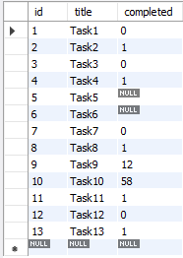
datatype – boolean
CREATE TABLE temp (col1 INT ,col2 BOOL, col3 BOOLEAN);
CREATE TABLE tasks ( id INT AUTO_INCREMENT PRIMARY KEY, title VARCHAR(255) NOT NULL, completed BOOLEAN);
INSERT INTO tasks VALUE(default, 'Task1', 0);
INSERT INTO tasks VALUE(default, 'Task2', 1);
INSERT INTO tasks VALUE(default, 'Task3', False);
INSERT INTO tasks VALUE(default, 'Task4', True);
INSERT INTO tasks VALUE(default, 'Task5', null);
INSERT INTO tasks VALUE(default, 'Task6', default);
INSERT INTO tasks VALUE(default, 'Task7’, 1 > 2);
INSERT INTO tasks VALUE(default, 'Task8’, 1 < 2);
INSERT INTO tasks VALUE(default, 'Task9', 12);
INSERT INTO tasks VALUE(default, 'Task10', 58);
INSERT INTO tasks VALUE(default, 'Task11', .75);
INSERT INTO tasks VALUE(default, 'Task12', .15);
INSERT INTO tasks VALUE(default, 'Task13', 'a' = 'a');
Note:
BOOL and BOOLEAN are synonym of TINYINT(1)

Slide 94
datatype – enum
An ENUM column can have a maximum of 65,535 distinct elements.
ENUM values are sorted based on their index numbers, which depend on the order in which the enumeration members were listed in the column specification.
Default value, NULL if the column can be NULL, first enumeration value if NOT NULL
CREATE TABLE temp (col1 INT, COL2 ENUM('A','B','C'));
INSERT INTO temp (col1, col2) VALUES(1, 1);
INSERT INTO temp(col1) VALUES (1); // NULL
CREATE TABLE temp (col1 INT, col2 ENUM('A','B','C') NOT NULL);
INSERT INTO temp(col1) VALUES (1); // First element from the ENUM datatype
CREATE TABLE temp (col1 INT, col2 ENUM('') NOT NULL);
INSERT INTO temp (col1, col2) VALUES (1,'This is the test'); // NULL
CREATE TABLE temp (col1 INT, COL2 ENUM('A','B','C') default 'D' ); // Invalid default value for 'COL2'
IMP:
MySQL maps [ membership ENUM('Silver', 'Gold', 'Diamond', 'Platinum') ] these enumeration member to a numeric index where Silver=1, Gold=2, Diamond=3, Platinum=4 respectively.

Slide 95
datatype – enum
An ENUM column can have a maximum of 65,535 distinct elements.
size ENUM('small', 'medium', 'large', 'x-large')
membership ENUM('Silver', 'Gold', 'Diamond', 'Platinum')
interest ENUM('Movie', 'Music', 'Concert')
zone ENUM('North', 'South', 'East', 'West')
season ENUM('Winter', 'Summer', 'Monsoon', 'Autumn')
sortby ENUM('Popularity', 'Price -- Low to High', 'Price -- High to Low', 'Newest First')
status ENUM('active', 'inactive', 'pending', 'expired', 'shipped', 'in-process', 'resolved', 'on-hold', 'cancelled', 'disputed')
Note:
You cannot use user variable as an enumeration value. This pair of statements do not work:
SET @mysize = 'medium';
CREATE TABLE sizes ( size ENUM('small', @mysize, 'large')); // error

Slide 96
datatype – set
A SET column can have a maximum of 64 distinct members.
A SET is a string object that can have zero or more values, each of which must be chosen from a list of permitted values specified when the table is created.
SET column values that consist of multiple set members are specified with members separated by commas (,) without leaving a spaces.
CREATE TABLE clients(
id INT AUTO_INCREMENT PRIMARY KEY,
name VARCHAR(10),
membership ENUM('Silver', 'Gold', 'Premium', 'Diamond'),
interest SET('Movie', 'Music', 'Concert'));
INSERT INTO clients (name, membership, interest) VALUES('Saleel', 'Gold', 'Music');
INSERT INTO clients (name, membership, interest) VALUES('Saleel', 'Premium', 'Movie, Concert');
IMP:
The SET data type allows you to specify a list of values to be inserted in the column, like ENUM. But, unlike the ENUM data type, which lets you choose only one value, the SET data type allows you to choose multiple values from the list of specified values.

Slide 97
Use a CREATE TABLE statement to specify the layout of your table.
CREATE TABLE `123` (c1 INT, c2 VARCHAR(10));
Remember:
Max 4096 columns per table provided the row size <= 65,535 Bytes
create table
Use a CREATE TABLE statement to specify the layout of your table.
Note:
USER TABLES: This is a collection of tables created and maintained by the user. Contain USER information.
DATA DICTIONARY: This is a collection of tables created and maintained by the MySQL Server. It contains database information. All data dictionary tables are owned by the SYS user.

Slide 98
create table
Use a CREATE TABLE statement to specify the layout of your table.
Remember:
by default, tables are created in the default database, using the InnoDB storage engine.
table name should not begin with a number or special symbols.
table name can start with _table_name (underscore) or $table_name (dollar sign)
table name and column name can have max 64 char.
multiple words as table_name is invalid, if you want to give multiple words as table_name then give it in `table_name` (backtick)
error occurs if the table exists.
error occurs if there is no default database.
error occurs if the database does not exist.
Note:
Table names are stored in lowercase on disk. MySQL converts all table names to lowercase on storage. This behavior also applies to database names and table aliases.
e.g. show variables like 'lower_case_table_names';

Slide 99
create table
syntax
e.g.
CREATE TABLE student (
ID INT,
firstName VARCHAR(45),
lastName VARCHAR(45),
DoB DATE,
emailID VARCHAR(128)
);
CREATE [TEMPORARY] TABLE [IF NOT EXISTS] tbl_name
(create_defineation, . . .)
[table_options]
[partition_options]
create_definition:
col_name column_definition
column_definition:
data_type [NOT NULL | NULL] [DEFAULT default_value]
[AUTO_INCREMENT] [UNIQUE [KEY] | [PRIMARY] KEY]
[reference_definition]
| data_type [GENERATED ALWAYS] AS (expression) [VIRTUAL]
[VISIBLE | INVISIBLE]
table_options:
ENGINE [=] engine_name
show engines;
set default_storage_engine = memory;

Slide 100
default value
The DEFAULT specifies a default value for the column.
BLOB, TEXT, GEOMETRY or JSON column can't have a default value.
e.g. CREATE TABLE temp(c1 TEXT DEFAULT('PUNE'));

Slide 101

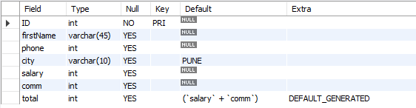
default value
col_name data_type DEFAULT value
The DEFAULT specifies a default value for the column.
CREATE TABLE posts (
postID INT,
postTitle VARCHAR(255),
postDate DATETIME DEFAULT NOW(),
deleted INT
);
# version 8.0 and above.
CREATE TABLE empl (
ID INT PRIMARY KEY,
firstName VARCHAR(45),
phone INT,
city VARCHAR(10) DEFAULT 'PUNE',
salary INT,
comm INT,
total INT DEFAULT(salary + comm)
);

Slide 102

default value - insert
The DEFAULT example.
CREATE TABLE t (
c1 INT,
c2 INT DEFAULT 1,
c3 INT DEFAULT 3,
);
INSERT INTO t VALUES();
INSERT INTO t VALUES(-1, DEFAULT, DEFAULT);
INSERT INTO t VALUES(-2, DEFAULT(c2), DEFAULT(c3));
INSERT INTO t VALUES(-3, DEFAULT(c3), DEFAULT(c2));

Slide 103
default value - update
The DEFAULT example.
CREATE TABLE temp (
c1 INT,
c2 INT,
c3 INT DEFAULT(c1 + c2),
c4 INT DEFAULT(c1 * c2 )
);
INSERT INTO temp(c1, c2, c3, c4) VALUES(1, 1, 1, 1);
INSERT INTO temp(c1, c2, c3, c4) VALUES(2, 2, 2, 2);
UPDATE temp SET c3 = DEFAULT;
UPDATE temp SET c4 = DEFAULT;

Slide 104
insert rows
INSERT is used to add a single or multiple tuple to a relation. We must specify the relation name and a list of values for the tuple. The values should be listed in the same order in which the corresponding attributes were specified in the CREATE TABLE command.
You can insert data using following methods:
INSERT ... VALUES
INSERT ... SET
INSERT ... SELECT

Slide 105
INSERT can violate for any of the four types of constraints.
Important:
If an attribute value is not of the appropriate data type.
Entity integrity can be violated if a key value in the new tuple t already exists in another tuple in the relation r(R).
Entity integrity can be violated if any part of the primary key of the new tuple t is NULL.
Referential integrity can be violated if the value of any foreign key in t refers to a tuple that does not exist in the referenced relation.
INSERT will also fail in following cases.
Important :
Your database table has X columns, Where as the VALUES you are passing are for (X-1) or (X+1). This mismatch of column-values will giving you the error.
Inserting a string into a string column (CHAR, VARCHAR, TEXT, or BLOB) that exceeds the column maximum length. The value is truncated to the column maximum length.

Slide 106
INSERT is used to add a single or multiple tuple to a relation. We must specify the relation name and a list of values for the tuple. The values should be listed in the same order in which the corresponding attributes were specified in the CREATE TABLE command.
A second form of the INSERT statement allows the user to specify explicit attribute names that correspond to the values provided in the INSERT command. This is useful if a relation has many attributes but only a few of those attributes are assigned values in the new tuple. However, the values must include all attributes with NOT NULL specification and no default value. Attributes with NULL allowed or DEFAULT values are the ones that can be left out.
insert rows using values

Slide 107
dml- insert … values
INSERT inserts new row(s) into an existing table. The INSERT ... VALUES
INSERT [IGNORE] [INTO] tbl_name [PARTITION (partition_name [, partition_name] ...)] [ (col_name, . . .) ] { VALUES | VALU E } ( { expr | DEFAULT }, . . .), (. . .), . . . [ ON DUPLICATE KEY UPDATE assignment_list ]
The affected-rows value for an INSERT can be obtained using the ROW_COUNT() function.
Column Values
Column List
Inserting multiple rows

Slide 108
dml- insert … values
INSERT inserts new rows into an existing table. The INSERT ... VALUES
INSERT [IGNORE] [INTO] tbl_name [PARTITION (partition_name [, partition_name] ...)] [ (col_name, . . .) ] { VALUES | VALUE } [ROW] ( { expr | DEFAULT }, . . .), [ROW] (. . .), [ROW] . . . [ ON DUPLICATE KEY UPDATE assignment_list ]
CREATE TABLE student (
ID INT PRIMARY KEY,
nameFirst VARCHAR(45),
nameLast VARCHAR(45),
DoB DATE ,
emailID VARCHAR(128)
);
e.g.
INSERT INTO student VALUES (29, 'sharmin', 'patil', '1999-11-10', 'sharmin.patil@gmail.com');
INSERT INTO student (ID, nameFirst, nameLast, DOB, emailID) VALUES (30, 'john', 'thomas', '1983-11-10', 'john.thomas@gmail.com’);
INSERT INTO student (ID, nameFirst, emailID) VALUES (31, 'jack', 'jack.thorn@gmail.com');
INSERT INTO student (ID, nameFirst) VALUES (32, 'james'), (33, 'jr. james'), (34, 'sr. james');

Slide 109
insert multiple rows

Slide 110
dml- insert … values
INSERT inserts new rows into an existing table. The INSERT ... VALUES
INSERT [INTO] tbl_name { VALUES | VALUE } [ROW] ( { expr | DEFAULT }, . . .), [ROW] (. . .), [ROW] (. . .)
CREATE TABLE student (
ID INT PRIMARY KEY,
nameFirst VARCHAR(45),
nameLast VARCHAR(45),
DoB DATE ,
emailID VARCHAR(128)
);
e.g.
INSERT INTO student (ID, nameFirst) VALUES (32, 'james'), (33, 'jr. james'), (34, 'sr. james');
INSERT INTO student (ID, nameFirst) VALUES ROW (32, 'james'), ROW(33, 'jr. james'), ROW(34, 'sr. james');

Slide 111
Do not use the * operator in your SELECT statements. Instead, use column names. Reason is that in MySQL Server scans for all column names and replaces the * with all the column names of the table(s) in the SELECT statement. Providing column names avoids this search-and-replace, and enhances performance.
SELECT statement…
SELECT what_to_select
FROM which_table
WHERE conditions_to_satisfy;

Slide 112
SELECT CLAUSE
The SELECT statement retrieves or extracts data from tables in the database.
You can use one or more tables separated by comma to extract data.
You can fetch one or more fields/columns in a single SELECT command.
You can specify star (*) in place of fields. In this case, SELECT will return all the fields.
SELECT can also be used to retrieve rows computed without reference to any table e.g. SELECT 1 + 2;

Slide 113
Capabilities of SELECT Statement
SELECTION
PROJECTION
JOINING

Slide 114
ORDER BY in UPDATE: if the table contains two values 1 and 2 in the id column and 1 is updated to 2 before 2 is updated to 3, an error occurs. To avoid this problem, add an ORDER BY clause to cause the rows with larger id values to be updated before those with smaller values.
Note:
Here c1 column is a Primary Key
UPDATE temp SET c1 = c1 - 1 ORDER BY c1 ASC; # In case of decrement
UPDATE temp SET c1 = c1 + 1 ORDER BY c1 DESC; # In case of increment
In a SET statement, = is treated identically to :=
single-table update
UPDATE is used to change/modify the values of some attributes of one or more selected tuples.
SET @x := 0;
UPDATE emp SET id = @x := @x + 1;
UPDATE t, (SELECT isactive, COUNT(isactive) r1 FROM emp GROUP BY isactive) a SET t.c2 = a.r1 WHERE t.c1 = a.isactive;
mysql> SELECT * FROM t;
+-------+--------+
| c1 | c2 |
+-------+--------+
| 0 | NULL |
| 1 | NULL |
+-------+--------+
+-------+------+
| c1 | c2 |
+-------+------+
| 0 | 6 |
| 1 | 14 |
+-------+------+
e.g.
Update top 2 rows.
Update UnitPrice for the top 5 most expensive products.

Slide 115
UPDATE can violate.
Important:
TODO

Slide 116
single-table update
The UPDATE statement updates columns of existing rows in the named table with new values. The SET clause indicates which columns to modify and the values they should be given. The WHERE clause, if given, specifies the conditions that identify which rows to update. With no WHERE clause, all rows are updated. If the ORDER BY clause is specified, the rows are updated in the order that is specified. The LIMIT clause places a limit on the number of rows that can be updated.
UPDATE tbl_name SET col_name1 = { expr1 | DEFAULT } [, col_name2 = { expr2 | DEFAULT } ] . . .
[WHERE where_condition]
[ORDER BY . . .]
[LIMIT row_count]
UPDATE temp SET dname = 'new_value' LIMIT 2;
UPDATE temp SET c1 = 'new_value' ORDER BY loc LIMIT 2;
UPDATE temp SET c1 := 'new_value' WHERE deptno < 50;
UPDATE temp SET c1 := 'new_value' WHERE deptno < 50 LIMIT 2;
ALTER TABLE dept ADD SUMSALARY INT;
UPDATE dept SET sumsalary = (SELECT SUM(sal) FROM emp WHERE emp.deptno = dept.deptno GROUP BY emp.deptno);
UPDATE candidate SET totalvotes = (SELECT COUNT(*) FROM votes WHERE candidate.id = votes.candidateID GROUP BY votes.candidateID);
UPDATE duplicate SET id = ( SELECT @cnt := @cnt + 1 );

Slide 117
single-table delete
DELETE is used to delete tuples from a relation.

Slide 118
DELETE can violate only in referential integrity.
Important:
The DELETE operation can violate only referential integrity. This occurs if the tuple t being deleted is referenced by foreign keys from other tuple t in the database.

Slide 119
single-table delete
The DELETE statement deletes rows from tbl_name and returns the number of deleted rows. To check the number of deleted rows, call the ROW_COUNT() function. The optional WHERE clause identify which rows to delete. With no WHERE clause, all rows are deleted. If the ORDER BY clause is specified, the rows are deleted in the order that is specified. The LIMIT clause places a limit on the number of rows that can be deleted.
DELETE FROM tbl_name
[PARTITION (partition_name [, partition_name] . . .)]
[WHERE where_condition]
[ORDER BY . . .]
[LIMIT row_count]
Note:
LIMIT clauses apply to single-table deletes, but not multi-table deletes.
DELETE FROM temp;
DELETE FROM temp ORDER BY loc LIMIT 2;
DELETE FROM temp WHERE deptno < 50;
DELETE FROM temp WHERE deptno < 50 LIMIT 2;

Slide 120
auto_increment column
The AUTO_INCREMENT attribute can be used to generate a unique number/identity for new rows.

Slide 121
auto_increment
IDENTITY is a synonym to the LAST_INSERT_ID variable.
col_name data_type AUTO_INCREMENT [UNIQUE [KEY] | [PRIMARY] KEY]
Remember:
There can be only one AUTO_INCREMENT column per table.
it must be indexed.
it cannot have a DEFAULT value.
it works properly only if it contains only positive values.
It applies only to integer and floating-point types.
when you insert a value of NULL or 0 into AUTO_INCREMENT column, it generates next value.
use LAST_INSERT_ID() function to find the row that contains the most recent AUTO_INCREMENT value.
SELECT @@IDENTITY
SELECT LAST_INSERT_ID()
SET INSERT_ID = 7
CREATE TABLE posts (
c1 INT UNIQUE KEY AUTO_INCREMENT,
c2 VARCHAR(20)
) AUTO_INCREMENT = 2; // auto_number will start with value 2.

Slide 122


auto_increment
The auto_increment specifies a auto_increment value for the column.
CREATE TABLE posts (
postID INT AUTO_INCREMENT UNIQUE KEY,
postTitle VARCHAR(255),
postDate DATETIME DEFAULT NOW(),
deleted INT
);
CREATE TABLE comments (
commentID INT AUTO_INCREMENT PRIMARY KEY,
comment TEXT,
commentDate DATETIME DEFAULT NOW(),
deleted INT
);
CREATE TABLE animals(id INT NOT NULL AUTO_INCREMENT, breed INT, PRIMARY KEY (id, breed)); //valid
CREATE TABLE animals(id NT NOT NULL, breed INT AUTO_INCREMENT, PRIMARY KEY (id, breed)); //invalid

Slide 123
auto_increment
auto_increment_increment – is the incremental value, controls the interval between successive column values.
auto_increment_offset – determines the starting value for the AUTO_INCREMENT field; this value is used for the first record inserted into the table.
SET @@session.auto_increment_offset = 5 ;
SET @@session.auto_increment_increment = 10 ;
ALTER TABLE temp AUTO_INCREMENT = 0;

Slide 124
auto_increment
NO_AUTO_VALUE_ON_ZERO affects handling of AUTO_INCREMENT columns. Normally, you generate the next sequence number for the column by inserting either NULL or 0 into it. NO_AUTO_VALUE_ON_ZERO suppresses this behaviour for 0 so that only NULL generates the next sequence number.
SET sql_mode = '';
SET sql_mode = 'NO_AUTO_VALUE_ON_ZERO';

Slide 125
CREATE TABLE . . . LIKE . . ., the destination table preserves generated column information from the original table.
CREATE TABLE . . . SELECT . . ., the destination table does not preserves generated column information from the original table.
generated column
Remember:
Stored functions and user-defined functions are not permitted.
Stored procedure and function parameters are not permitted.
Variables (system variables, user-defined variables, and stored program local variables) are not permitted.
Subqueries are not permitted.
The AUTO_INCREMENT attribute cannot be used in a generated column definition.
Triggers cannot use NEW.COL_NAME or use OLD.COL_NAME to refer to generated columns.
Stored column cannot be converted to virtual column and virtual column cannot be converted to stored column.
Generated column can be made as invisible column.
Note:
The expression can contain literals, built-in functions with no parameters, operators, or references to any column within the same table. If you use a function, it must be scalar and deterministic.

Slide 126
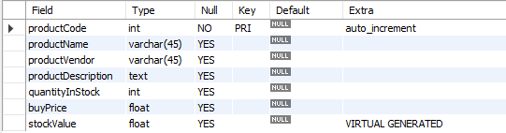
virtual column - generated always
col_name data_type [GENERATED ALWAYS] AS (expression) [VIRTUAL | STORED]
VIRTUAL: Column values are not stored, but are evaluated when rows are read, immediately after any BEFORE triggers. A virtual column takes no storage.
STORED: Column values are evaluated and stored when rows are inserted or updated. A stored column does require storage space and can be indexed.
Note:
The default is VIRTUAL if neither keyword is specified.
CREATE TABLE product(
productCode INT AUTO_INCREMENT PRIMARY KEY,
productName VARCHAR(45),
productVendor VARCHAR(45),
productDescription TEXT,
quantityInStock INT,
buyPrice FLOAT,
stockValue FLOAT GENERATED ALWAYS AS(quantityInStock * buyPrice) VIRTUAL
);

Slide 127
virtual column – MODIFY with ALTER command
PROBLEMS
col_name data_type [GENERATED ALWAYS] AS (expression) [VIRTUAL | STORED]
Note:
Virtual column cannot be converted to stored column.
CREATE TABLE product1(
productCode INT,
quantityInStock INT,
buyPrice INT,
stockValue FLOAT GENERATED ALWAYS AS (quantityInStock * buyPrice) VIRTUAL
);
ALTER TABLE product1 MODIFY stockValue FLOAT (12, 2); // error: We are trying to convert virtual column [ GENERATED ALWAYS AS ] to stored column by not giving GENERATED ALWAYS AS
Then What-→ give
ALTER TABLE product1 MODIFY stockValue FLOAT (12, 2) GENERATED ALWAYS AS (quantityInStock * buyPrice) VIRTUAL ;

Slide 128
virtual column – MODIFY with ALTER command
PROBLEMS
col_name data_type [GENERATED ALWAYS] AS (expression) [VIRTUAL | STORED]
Note:
Stored column cannot be converted to virtual column.
CREATE TABLE product1(
productCode INT,
quantityInStock INT,
buyPrice INT,
stockValue FLOAT
);
ALTER TABLE product1 MODIFY stockValue FLOAT GENERATED ALWAYS AS (quantityInStock * buyPrice) VIRTUAL; // error: We are trying to convert stored column to virtual column by giving GENERATED ALWAYS AS

Slide 129
visible / invisible columns
Columns are visible by default. To explicitly specify visibility for a new column, use a VISIBLE or INVISIBLE keyword as part of the column definition for CREATE TABLE or ALTER TABLE.
Note:
An invisible column is normally hidden to queries, but can be accessed if explicitly referenced. Prior to MySQL 8.0.23, all columns are visible.
A table must have at least one visible column. Attempting to make all columns invisible produces an error.
SELECT * does not include invisible columns.

Slide 130
invisible column
col_name data_type INVISIBLE
CREATE TABLE employee (
ID INT AUTO_INCREMENT PRIMARY KEY,
firstName VARCHAR(40),
salary INT,
commission INT,
total INT DEFAULT(salary + commission) INVISIBLE
tax INT GENERATED ALWAYS AS (total * .25) VIRTUAL INVISIBLE
) ;
CREATE TABLE employee (
ID INT PRIMARY KEY AUTO_INCREMENT INVISIBLE ,
firstName VARCHAR(40)
) ;
INSERT INTO employee(firstName, salary, commission) VALUES('ram', 4700, -700);
INSERT INTO employee(firstName, salary, commission) VALUES('pankaj', 3400, NULL);
INSERT INTO employee(firstName, salary, commission) VALUES('rajan', 3200, 250);
INSERT INTO employee(firstName, salary, commission) VALUES('ninad', 2600, 0);
INSERT INTO employee(firstName, salary, commission) VALUES('omkar', 4500, 300);
SELECT * FROM employee;
ALTER TABLE employee MODIFY total INT VISIBLE;
ALTER TABLE employee MODIFY total INT INVISIBLE;

Slide 131
varbinary column
TODO
Note:
TODO
TODO
TODO

Slide 132
varbinary column
col_name VARBINARY
CREATE TABLE login (
ID INT AUTO_INCREMENT PRIMARY KEY,
userName VARCHAR(40),
password VARBINARY(40) INVISIBLE
) ;
INSERT INTO login(userName, password) VALUES('ram', 'ram@123');
INSERT INTO login(userName, password) VALUES('pankaj', 'pankaj');
INSERT INTO login(userName, password) VALUES('rajan', 'rajan');
INSERT INTO login(userName, password) VALUES('ninad', 'ninad');
INSERT INTO login(userName, password) VALUES('omkar', 'omkar');
SELECT * FROM login;
SELECT username, CAST(password as CHAR) FROM login;

Slide 133
MySQL Constraints define specific rules to the column(s) data in a database table. While inserting, updating, or deleting the data rows, if the rules of the constraint are not followed, the system will display an error message and the action will be terminated. The SQL Constraints are defined while creating a new table. We can also alter the table and add new SQL Constraints. The MySQL Constraints are mainly used to maintain data integrity.
constraints
CONSTRAINT is used to define rules to allow or restrict what values can be stored in columns. The purpose of inducing constraints is to enforce the integrity of a database.
CONSTRAINTS can be classified into two types –
Column Level
Table Level
The column level constraints can apply only to one column where as table level constraints are applied to the entire table.

Slide 134
Remember:
PRI => primary key
UNI => unique key
MUL=> is basically an index that is neither a primary key nor a unique key. The name comes from
"multiple" because multiple occurrences of the same value are allowed.
constraints
To limit or to restrict or to check or to control.
Note:
a table with a foreign key that references another table's primary key is MUL.
If more than one of the Key values applies to a given column of a table, Key displays the one with the highest priority, in the order PRI, UNI, and MUL.
If a table has a PRIMARY KEY or UNIQUE NOT NULL index that consists of a single column that has an integer type, you can use _rowid to refer to the indexed column in SELECT statements.

Slide 135
Remember:
A primary key cannot be NULL.
A primary key value must be unique.
A table has only one primary key.
The primary key values cannot be changed, if it is referred by some other column.
The primary key must be given a value when a new record is inserted.
An index can consist of 16 columns, at maximum. Since a PRIMARY KEY constraint automatically adds an index, it can't have more than 16 columns.
PRIMARY KEY constraint
Choosing a primary key is one of the most important steps in good database design. A primary key is a column that serves a special purpose. A primary key is a special column (or set of combined columns) in a relational database table, that is used to uniquely identify each record. Each database table needs a primary key.
Note:
Primary key in a relation is always associated with an INDEX object.
If, we give on a column a combination of NOT NULL & UNIQUE key then it behaves like a PRIMARY key.
If, we give on a column a combination of UNIQUE key & AUTO_INCREMENT then also it behaves like a PRIMARY key.
Stability: The value of the primary key should be stable over time and not change frequently.

Slide 136
constraints – add primary key
col_name data_type PRIMARY KEY
The following example creates tables with PRIMARY KEY column.
CREATE TABLE users (
ID INT PRIMARY KEY,
userName VARCHAR(25),
password VARCHAR(25),
email VARCHAR(255)
) ;
CREATE TABLE purchase_orders (
po_number INT,
vendor_id INT NOT NULL,
po_status INT NOT NULL,
PRIMARY KEY(po_number)
);
CREATE TABLE supplier (
supplier_id INT,
supplier_name VARCHAR(50),
contact_name VARCHAR(50),
constraint pk_supplier_id PRIMARY KEY(supplier_id)
);
CREATE TABLE person (
ID INT NOT NULL UNIQUE,
lastName VARCHAR(45),
firstName VARCHAR(45),
age INT,
email VARCHAR(255)
);

Slide 137
constraints – add composite primary key
The following example creates tables with COMPOSITE PRIMARY KEY column.
CREATE TABLE salesDetails (
customerID INT,
productID INT,
timeID INT,
qty INT,
salesDate DATE,
salesAmount INT,
PRIMARY KEY(customerID , productID, timeID)
) ;
customerID | productID | timeID | quantity | salesDate | salesAmount
Cust-001 | PRD-1 | D1-T1 | 100 | ●●●●●● | 25,00,000
Cust-001 | PRD-1 | D2-T1 | 100 | ●●●●●● | 25,00,000
Cust-001 | PRD-2 | D1-T1 | 200 | ●●●●●● | 50,00,000
Cust-002 | PRD-1 | D1-T1 | 100 | ●●●●●● | 25,00,000
Cust-004 | PRD-1 | D1-T1 | 100 | ●●●●●● | 25,00,000
Cust-004 | PRD-2 | D3-T1 | 200 | ●●●●●● | 50,00,000

Slide 138
constraints – add composite primary key
The following example creates tables with COMPOSITE PRIMARY KEY column.
CREATE TABLE payments (
paymentID INT,
orderID INT,
amount INT,
bankDetails VARCHAR(255),
PRIMARY KEY(paymentID , orderID)
) ;
Try It
CREATE TABLE try(c1 INT, c2 INT, c3 INT, c4 INT, c5 INT, c6 INT ,c7 INT, c8 INT, c9 INT, c10 INT,c11 INT,c12 INT, c13 INT, c14 INT, c15 INT, c16 INT,c17 INT, c18 INT, c19 INT, c20 INT, c21 INT, c22 INT, c23 INT, c24 INT, c25 INT, c26 INT, c27 INT, c28 INT, c29 INT , c30 INT, c31 INT, c32 INT, c33 INT, PRIMARY KEY(c1, c2, c3, c4, c5, c6, c7, c8, c9, c10, c11, c12, c13, c14, c15, c16, c17));
CREATE TABLE order_product (
orderID INT,
productID INT,
qty INT,
rate INT,
constraint pk_orderID_productID PRIMARY KEY(orderID, productID)
) ;

Slide 139
ALTER TABLE table_name
ADD [ CONSTRAINT constraint_name ]
PRIMARY KEY (column1, column2, . . . column_n)
Add Primary Key using Alter

Slide 140
constraints – add primary key using alter
You can use the ALTER TABLE statement to ADD PRIMARY KEY on existing column.
ALTER TABLE table_name
ADD [ CONSTRAINT constraint_name ]
PRIMARY KEY (column1, column2, . . . column_n)
CREATE TABLE vendors (
vendor_id INT,
vendor_name VARCHAR(25),
address VARCHAR(255)
);
ALTER TABLE vendors ADD PRIMARY KEY(vendor_id);
ALTER TABLE vendors ADD constraint pk_vendor_id PRIMARY KEY(vendor_id);

Slide 141
ALTER TABLE table_name
DROP PRIMARY KEY
Drop Primary Key

Slide 142
constraints – drop primary key
You can use the ALTER TABLE statement to DROP PRIMARY KEY.
ALTER TABLE table_name
DROP PRIMARY KEY
CREATE TABLE vendors (
vendor_id INT,
vendor_name VARCHAR(25),
address VARCHAR(255)
);
ALTER TABLE vendors DROP PRIMARY KEY;

Slide 143

"Live as if you were to die tomorrow.
Learn as if you were to live forever"

